Slide 1

Relational Databases
Relational Algebra (III)
Division , aggregate and grouping functions
Originally Prepared by Jennifer Widom

Slide 2
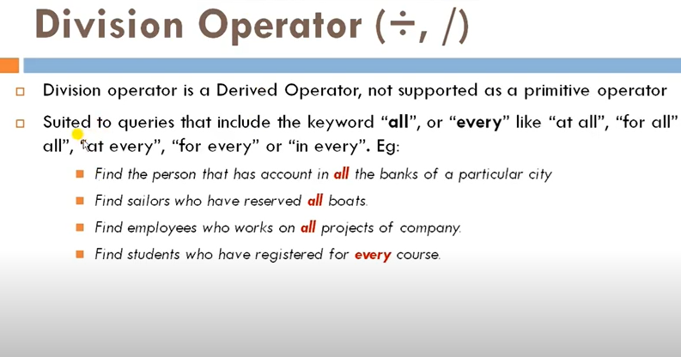

Slide 3
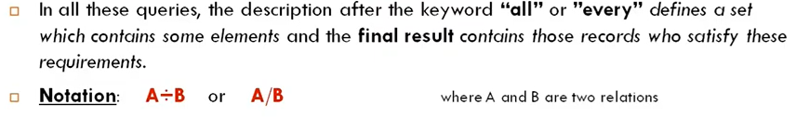
Division operator

Slide 4
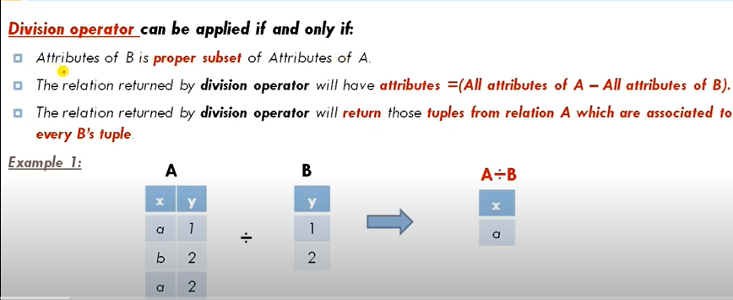

Slide 5
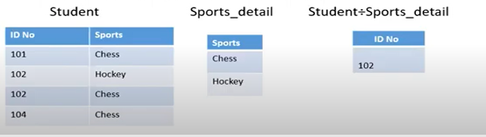

Slide 6
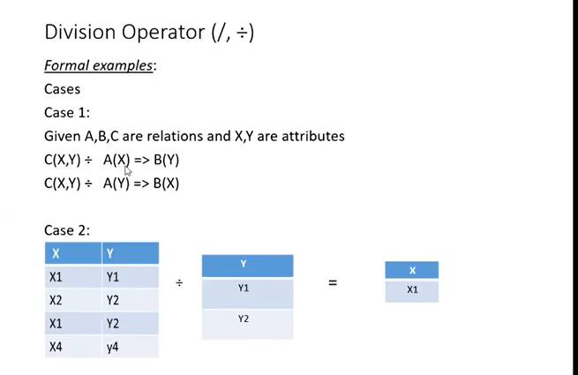
Examples

Slide 7
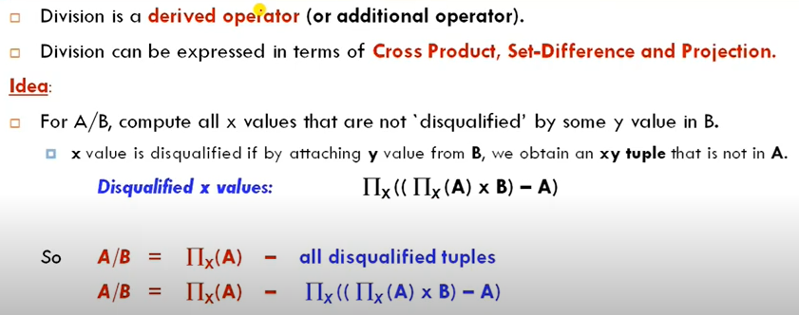
Division operator

Slide 8
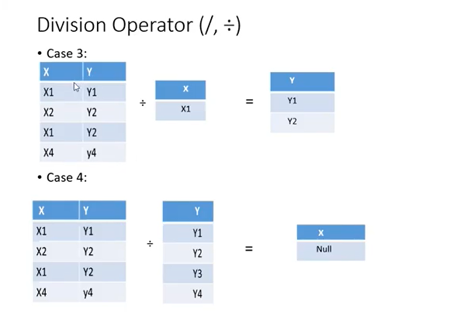
Examples

Slide 9
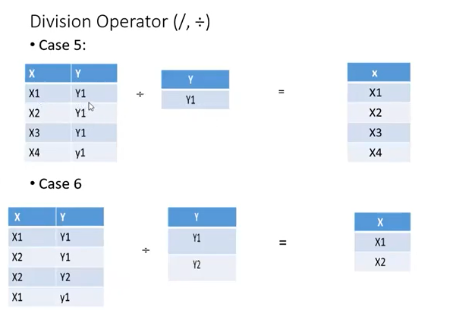
Examples

Slide 10
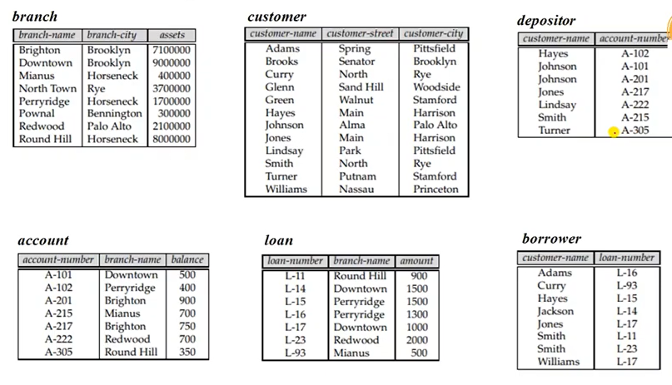

Slide 11



Example

Slide 12

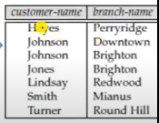
Example

Slide 13


Slide 14
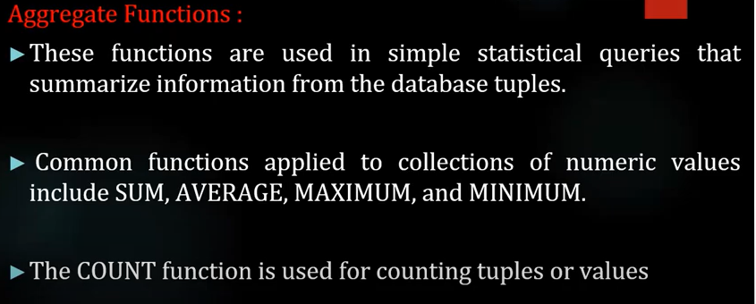

Slide 15
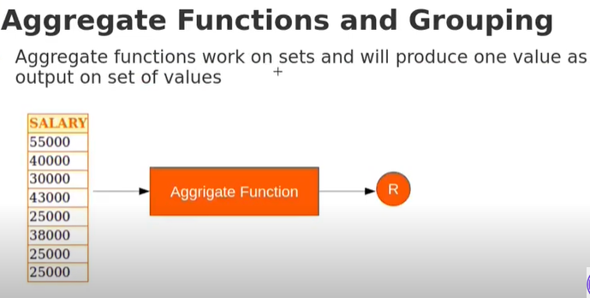

Slide 16
Aggregate Operations
ℑ_{AL}(R)
Applies aggregate function list, AL, to R to define a relation over the aggregate list.
AL contains one or more (<aggregate_function>, <attribute>) pairs .
Main aggregate functions are: COUNT, SUM, AVG, MIN, and MAX.

Slide 17
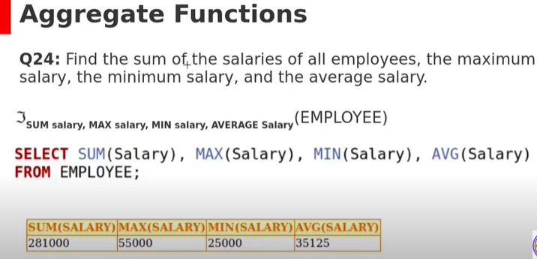
Example

Slide 18
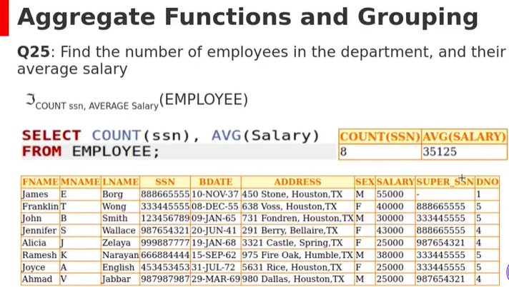

Slide 19
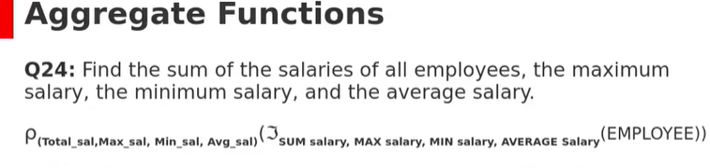


Slide 20
Grouping Operation
_{GA}ℑ_{AL}(R)
Groups tuples of R by grouping attributes, GA, and then applies aggregate function list, AL, to define a new relation.
AL contains one or more (<aggregate_function>, <attribute>) pairs.
Resulting relation contains the grouping attributes, GA, along with results of each of the aggregate functions.

Slide 21
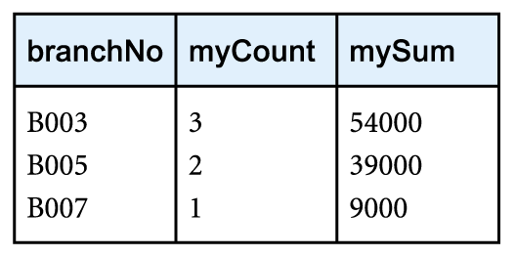
Example – Grouping Operation
Find the number of staff working in each branch and the sum of their salaries.
ρ_{R}(branchNo, myCount, mySum)
_{branchNo} ℑ _{COUNT staffNo,} _{SUM salary} (Staff)

Slide 22
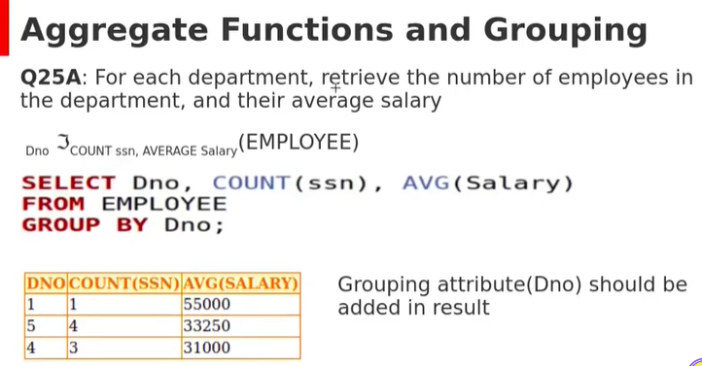
Grouping

Slide 23
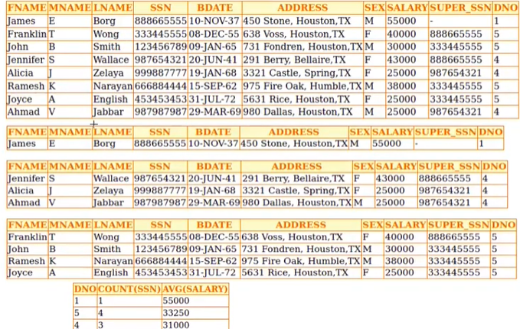

Slide 24
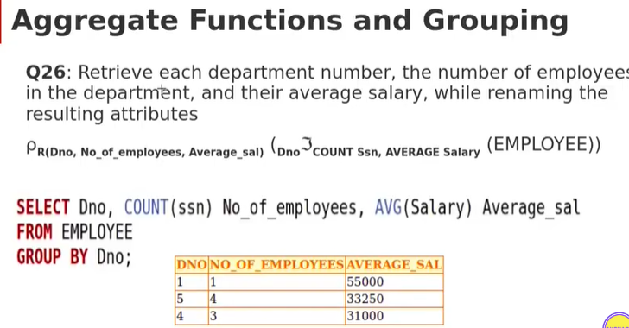

Slide 25
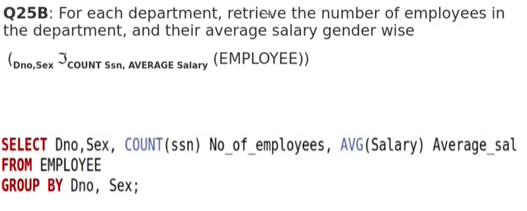
Example

Slide 26
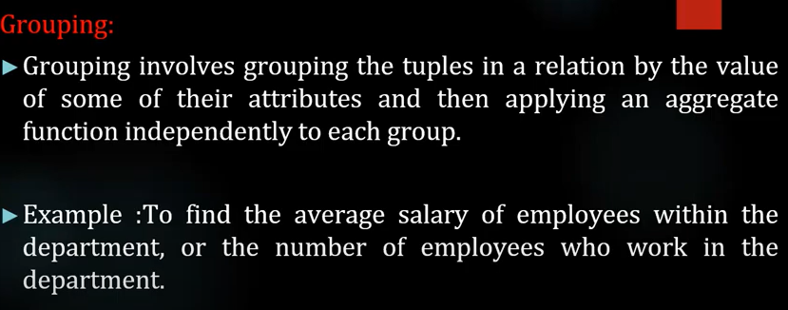
Example

Slide 27
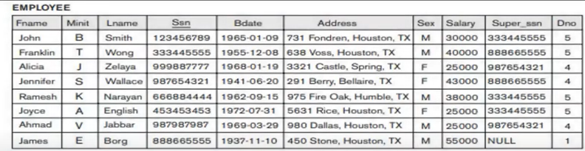
Example

Slide 28
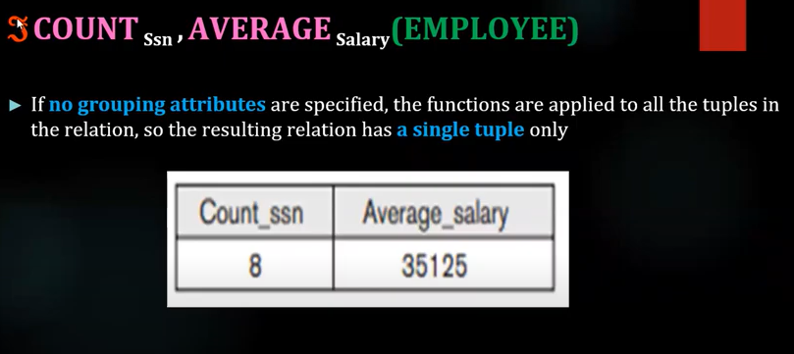

Slide 29

Example

Slide 30
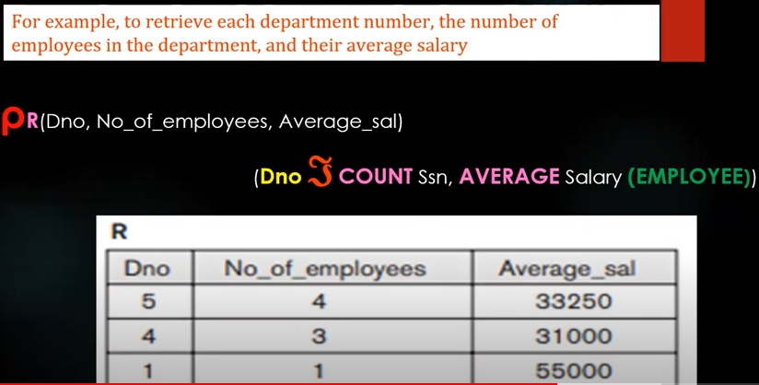
Example

Slide 31
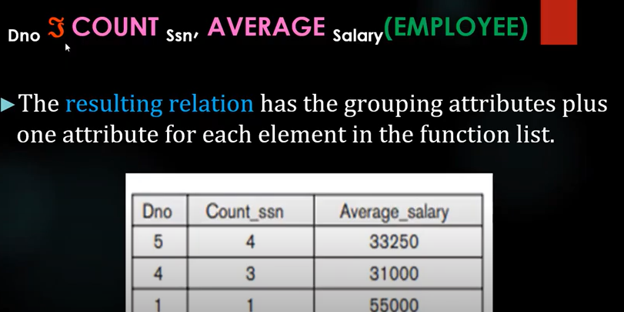
Example

